Slide 1

Web scraping

Slide 2

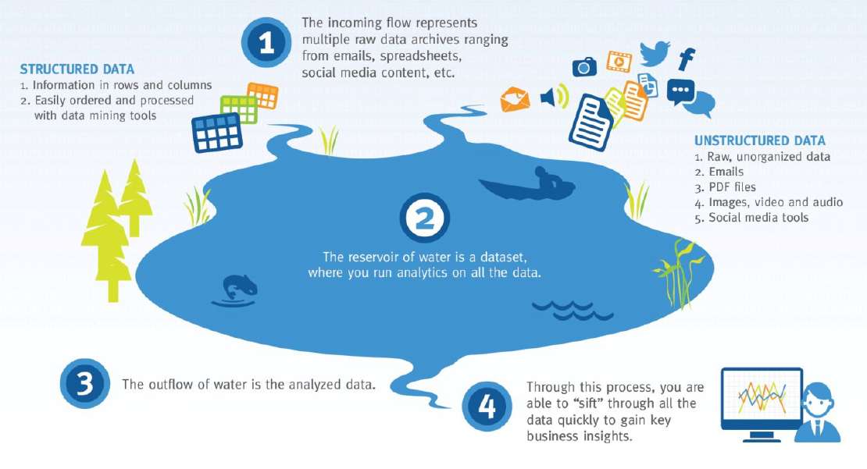
Data
scraping
Why?

Slide 3
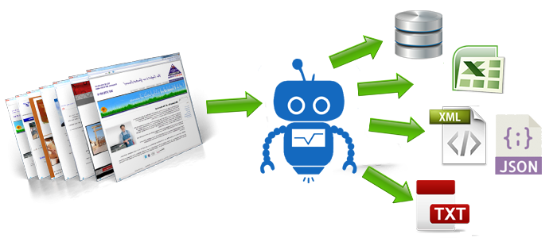
What
Web scraping
What?

Slide 4






Web scraping
What?
Static web
Parse HTML
Dynamic web
Call API

Slide 5



Static web
What?
URL request
Server

Slide 6

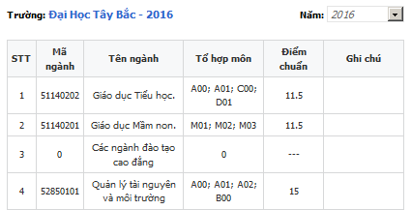
diemthi.tuyensinh247.com/diem-chuan/dai-hoc-tay-bac-TTB.html?y=2016
Static web
How?
htm %>%
html_node(xpath= '//*[@id="reBench"]/div[1]/div[3]/table[1]') %>%
html_table(header = T)

Slide 7



URL request
Dynamic web
What?
User interaction/AJAX request
Server

Slide 8





Direct AJAX request
Dynamic web
How?
Faster
Server
Browser
Slower
Server

Slide 9







Dynamic web
How?
Selenium
driver.
find_element_by_css_selector('#work > div:nth-child(2)').
find_elements_by_css_selector('div[id*="u_"]')

Slide 10



URL request + Token key
API call
API
What?
Server

Slide 11
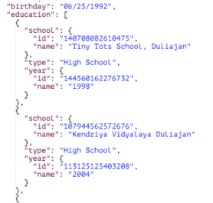
string = 'https://graph.facebook.com/v2.10/2313165?fields=reactions&access_token=' + ‘awcdgweh123123’
requests.get(string).json()
API
How?

Slide 12
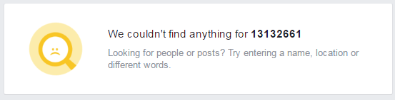
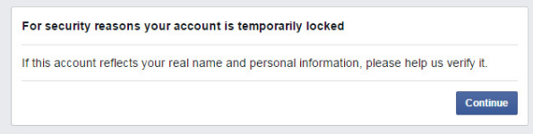

Facebook’s anti scraping mechanism
Blank result
Web
scraping
Problem
Facebook.com/vudt257
Redirect
Facebook.com
Block account
Block IP

Slide 13




Delay
Web
scraping
Solution
Switch account
VPN

